Slide 1

Group 6

Slide 2
Tables of Content
1. Introduction
2. Library’s
3. Knowing the data
4. Exploring Some Variables
5. Correlation of data
6. Preprocess
7 Modeling
1.1 Info's about datasets
5.1 Correlation Data
6.1 Importing Library’s
6.2 Setting X and Y
6.3 Splitting the X and Y in train & test
2.1 Importing library’s
2.2 Importing Datasets
3.1 Looking the data type
3.2 Null Numbers& Unique Values
3.3 The first rows of our dataset
7.1 Model 1 7.1.1 Random Forest
7.2 Model 2 7.2.1 Logistic Regression
7.2.2 Score Values
7.2.3 Cross Validation
7.2.4 ROC Curve
4.1 Plotting some graphical and descriptive information's

Slide 3
1. Introduction
Context
The original dataset contains 1000 entries with 20 categorial/symbolic attributes prepared by Prof. Hofmann. In this dataset, each entry represents a person who takes a credit by a bank. Each person is classified as good or bad credit risks according to the set of attributes. The link to the original dataset can be found below.

Slide 4
1.1 Info about dataset
Content
It is almost impossible to understand the original dataset due to its complicated system of categories and symbols. Thus, I wrote a small Python script to convert it into a readable CSV file. Several columns are simply ignored, because in my opinion either they are not important or their descriptions are obscure. The selected attributes are:
Age (numeric)
Sex (text: male, female)
Job (numeric: 0 - unskilled and non-resident, 1 - unskilled and resident, 2 - skilled, 3 - highly skilled)
Housing (text: own, rent, or free)
Saving accounts (text - little, moderate, quite rich, rich)
Checking account (numeric, in DM - Deutsch Mark)
Credit amount (numeric, in DM)
Duration (numeric, in month)
Purpose(text: car, furniture/equipment, radio/TV, domestic appliances, repairs, education, business, vacation/others
Risk (Value target - Good or Bad Risk)

Slide 5
2. Library’s
What is the Python Libraries?
A Python library is a reusable chunk of code that you may want to include in your programs/ projects.
Compared to languages like C++ or C, a Python libraries do not pertain to any specific context in Python. Here, a ‘library’ loosely describes a collection of core modules.
Essentially, then, a library is a collection of modules. A package is a library that can be installed using a package manager like rubygems or npm.

Slide 6
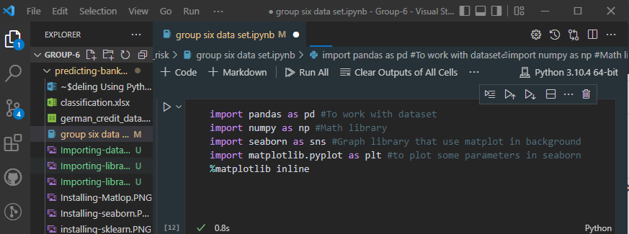
2.1 Importing Library’s

Slide 7
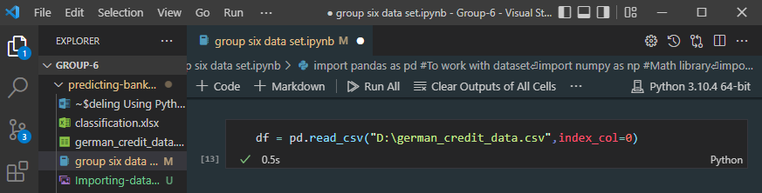
2.2 Importing Dataset

Slide 8
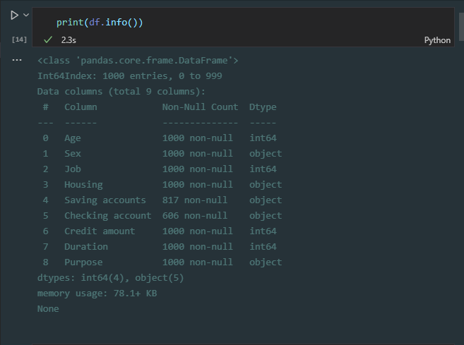
3. Knowing the Data 3.1 Looking the data types

Slide 9
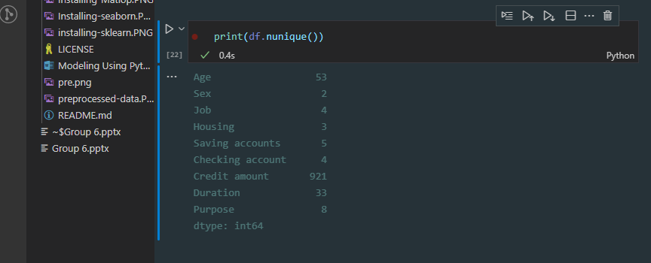
3.2 Unique Values

Slide 10
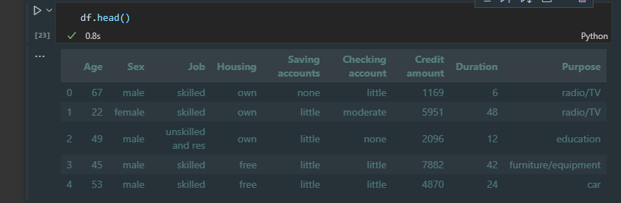
3.3 The first rows of our dataset

Slide 11
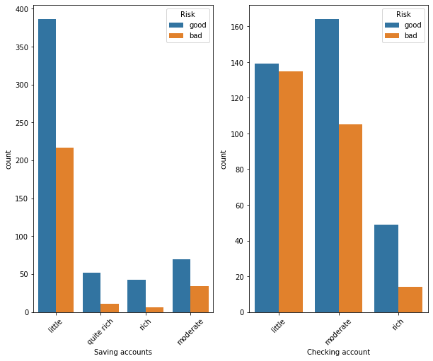
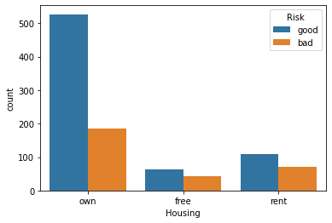
4.Exploring some Variables 4.1 Plotting some graphical and descriptive information's
Let's start looking through target variable and their distribution

Slide 12
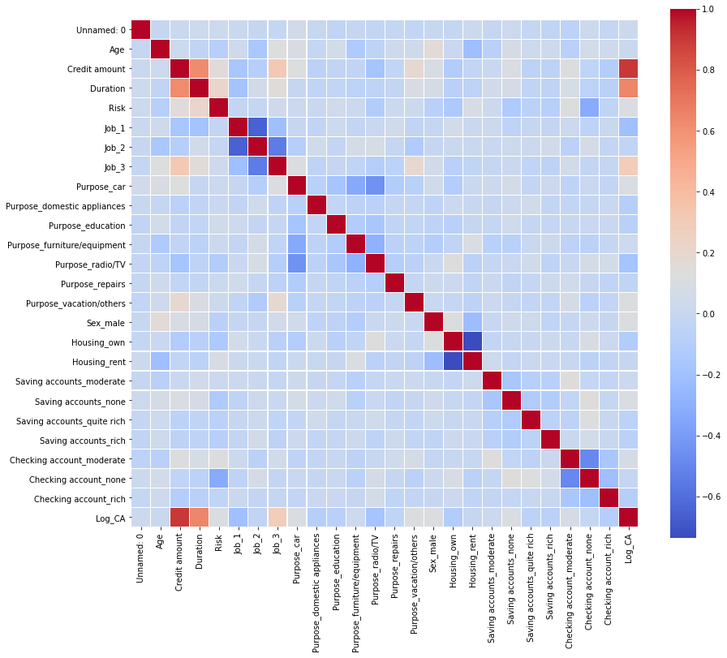
5. Correlation of data
Looking the correlation of the data

Slide 13
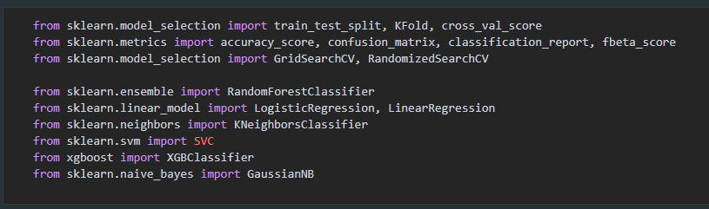
6. Preprocessing 6.1 Importing ML library's

Slide 14
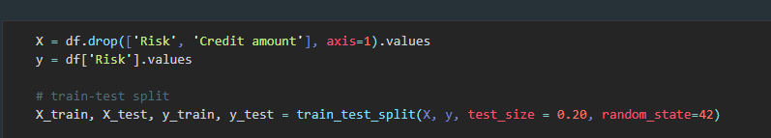
6.2 Setting X and Y 6.3 Splitting the X and Y in train & test

Slide 15
7. Modeling 7.1 Model 1
7.1.1 Random Forest
Using Random Forest to predict the credit score

Slide 16

THANK YOU
Ismail Mohamed
(MSc In Computer Science) +251927802065
Haaji.dheere@gmail.com

